Slide 1
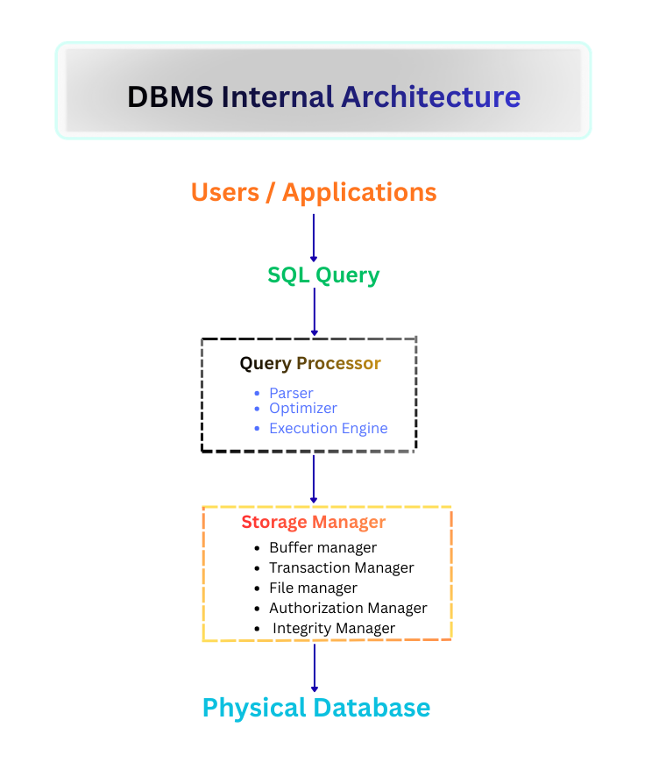
CSA0508-Database Management Systems
Software Components of a DBMS
PRESENTED BY :
Hema Priya T
192524467

Slide 2
What is a DBMS?
A Database Management System (DBMS) is software that allows users to define, create, maintain, and control access to a database.
It acts as an interface between the user/application and the physical database — users never interact with raw disk files directly.
It provides features like data security, backup, concurrent access, and consistent querying.
Example: Common DBMS software includes MySQL, Oracle Database, PostgreSQL, and Microsoft SQL Server.
2

Slide 3
Software Components of a DBMS
A DBMS is made up of several cooperating software components, not one single program. The three major components are:
Component | Main Role
Query Processor | Interprets and executes the queries submitted by the user
Storage Manager | Manages how and where data is physically stored on disk
Transaction Manager | Ensures every transaction is safe, consistent, and reliable
3

Slide 4
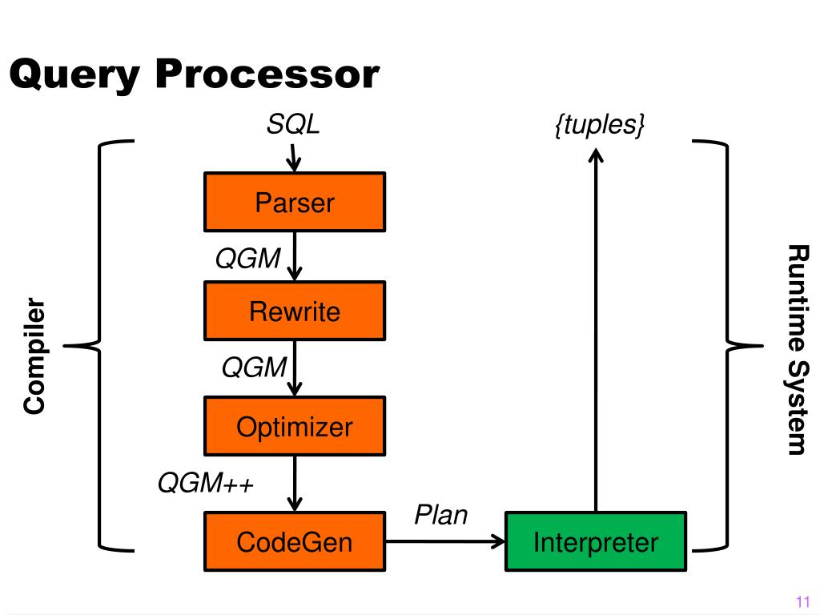
Query Processor: Overview
Interprets the queries given by the user in a high-level language like SQL.
Converts them into low-level instructions that the database engine understands.
Made up of four main parts: Parser, Translator, Optimizer, and Evaluator.
Each part hands its output to the next, forming a pipeline from raw query text to final result.
Example: SELECT name FROM Students WHERE marks > 90; passes through Parser → Translator → Optimizer → Evaluator before returning matching student names.
4

Slide 5
Parser
The first component that a query passes through.
Checks the syntax of the query — whether it follows correct SQL grammar.
Checks the semantics — whether the tables/columns mentioned actually exist in the schema.
If any error is found, it is reported back to the user immediately, before any execution begins.
Example: SELECT * FRM Students; is rejected by the parser because "FRM" is not valid SQL syntax (should be FROM).
5

Slide 6
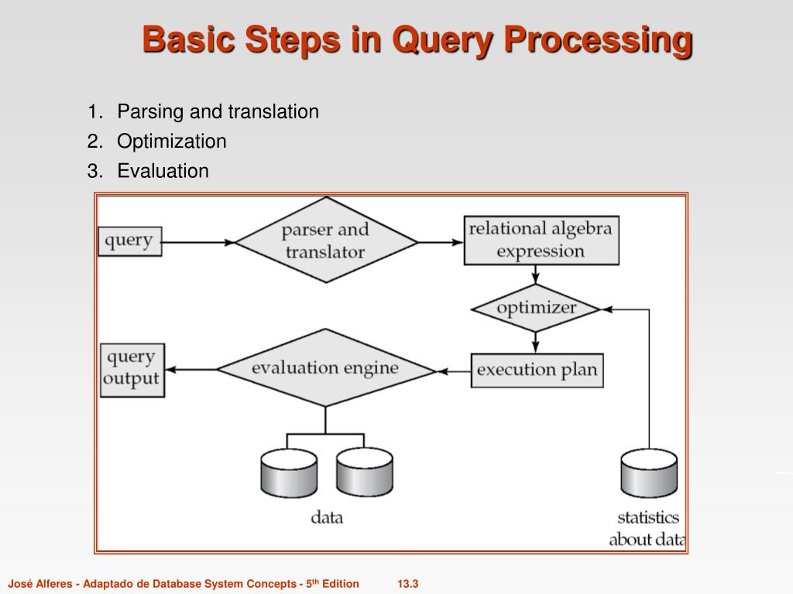
Query Translator
Converts the parsed query into an internal form the DBMS can work with.
This internal form is usually relational algebra — a mathematical notation for query operations.
Makes it easier for the next stage (the optimizer) to analyze and rearrange operations for efficiency.
Example: SELECT name FROM Students WHERE marks > 90; is translated into relational algebra as π name (σ marks>90 (Students)).
6

Slide 7
Query Optimizer
A single query can be executed in many different ways. The optimizer estimates the cost of each possible plan and picks the cheapest one. Example — finding students with marks > 90 in a 10,000-row table:
Execution Plan | Estimated Cost
Full table scan (check every row) | High — reads all 10,000 rows
Use index on 'marks' column | Low — reads only matching rows
7

Slide 8
Evaluator / Executor
Takes the optimized execution plan and runs it step-by-step against the actual database, producing the final result set. Example output for the student marks query:
Name | Marks
Aditi | 95
Rahul | 92
8

Slide 9
Storage Manager: Overview
The bridge between the data stored on physical disk and the queries/programs requesting it.
Hides all physical storage details from the rest of the system — users never need to know how data is laid out on disk.
Main components: Authorization & Integrity Manager, Transaction Manager Interface, File Manager, and Buffer Manager.
Example: When you run SELECT * FROM Orders, the Storage Manager locates the right disk blocks, loads them into memory, and hands the rows back — without you knowing the file layout.
10

Slide 10
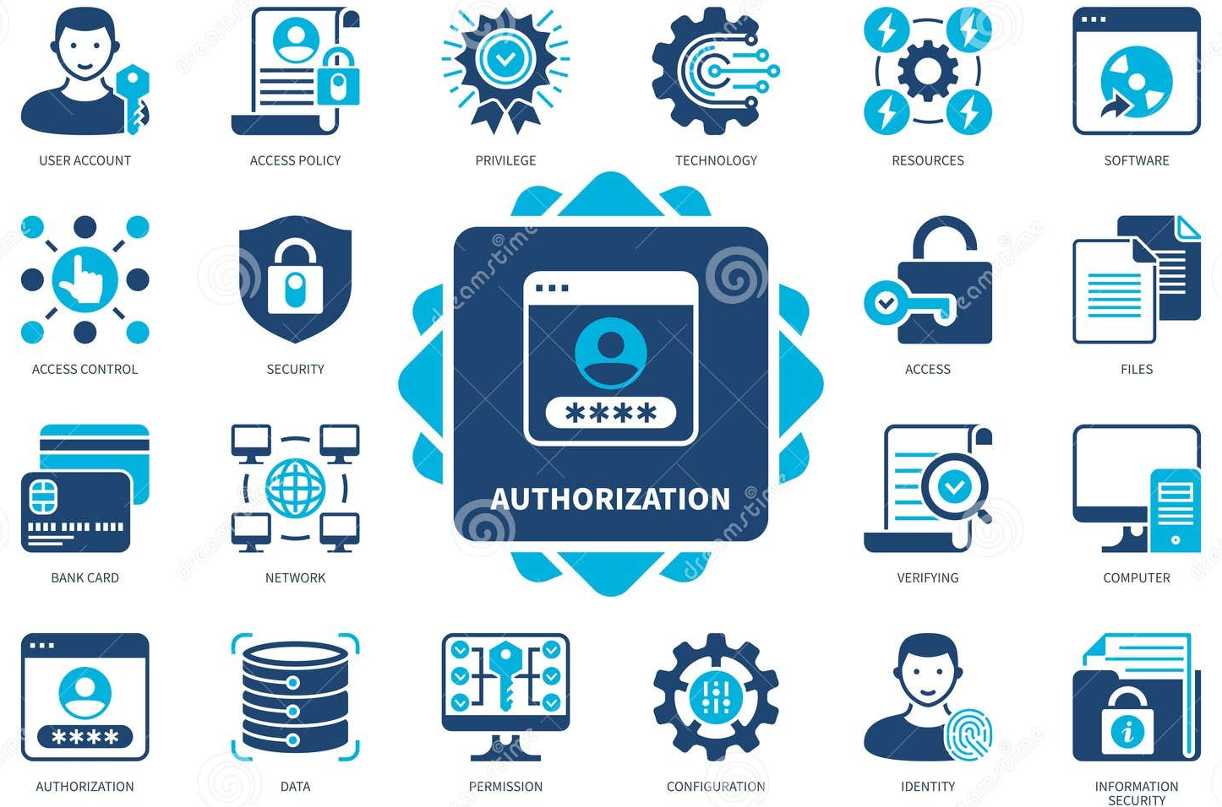
Authorization & Integrity Manager
Checks whether the user has permission to perform the requested operation (read, write, delete).
Enforces integrity constraints such as primary keys, foreign keys, and NOT NULL rules.
Prevents unauthorized access and invalid data entry before it reaches storage.
Example: A rule like Age >= 18 on a Voters table blocks any INSERT/UPDATE that tries to store Age = 15.
11

Slide 11
File Manager
Manages the allocation of disk space and organizes data into files and pages, using structures such as:
Structure | Best Used For
Heap file | Simple, unordered storage — fast inserts, slow searches
Sorted file | Data stored in order — faster range queries
B+ tree index | Very fast lookups and range queries on large tables
13

Slide 12
Buffer Manager
Disk access is slow compared to memory access.
Loads pages of data from disk into main memory, called the buffer pool.
Decides which pages to keep cached and which to remove, using a replacement policy (e.g., Least Recently Used).
Reduces the number of disk reads/writes needed, speeding up overall performance.
Example: If the same Customers page is requested twice in a row, the second request is served instantly from the buffer pool — no disk access needed.
14

Slide 13
Transaction Manager: Overview
A transaction is a sequence of operations treated as a single logical unit of work.
The Transaction Manager ensures the database stays correct even during failures or concurrent access.
It enforces four guarantees, known as the ACID properties.
Example: Transferring ₹500 from Account A to Account B involves two steps (debit A, credit B) — both must succeed together, or neither should happen.
15

Slide 14
ACID Properties: Atomicity & Consistency
Property | Meaning | Example
Atomicity | A transaction is all-or-nothing. | If the credit step fails after the debit, the debit is rolled back too.
Consistency | A transaction moves the database from one valid state to another. | Total balance across A and B stays the same before and after the transfer.
16

Slide 15
ACID Properties: Isolation & Durability
Property | Meaning | Example
Isolation | Concurrent transactions don't see each other's uncommitted changes. | Two people booking the last seat won't both succeed.
Durability | Once committed, changes survive even a crash. | A confirmed transfer stays recorded even if the server restarts.
17

Slide 16
Why Transactions Matter
Multiple users may access the database at the same time.
Systems can crash or lose power unexpectedly.
Without proper transaction management, data could become inconsistent or corrupted.
The Transaction Manager protects against both concurrency issues and system failures.
Example: An online store handling thousands of simultaneous orders relies on transactions so no two customers are ever sold the same last item in stock.
18

Slide 17
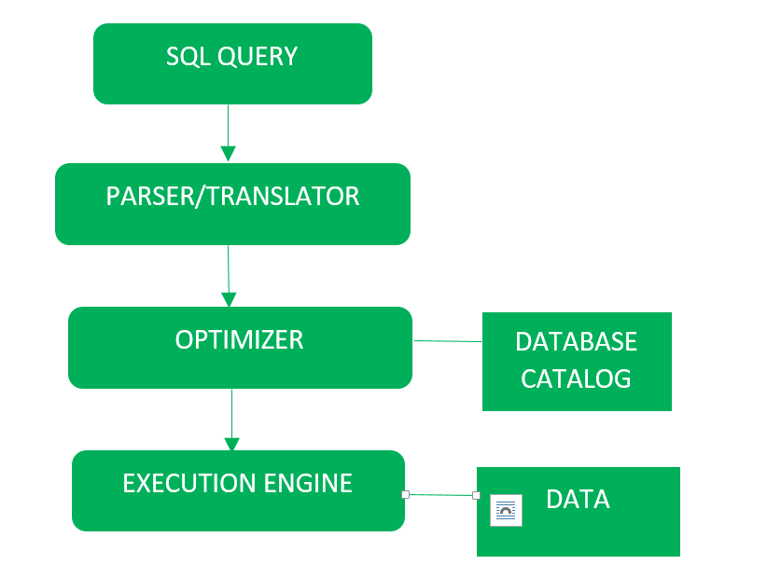
How the Components Work Together
Add image here (flow diagram / process arrows)
A single query passes through all three components before a result reaches the user:
1. User submits a query
2. Query Processor parses, optimizes, and plans execution
3. Transaction Manager wraps the operation as a safe transaction
4. Storage Manager reads/writes the actual data on disk
5. Result is returned to the user
19

Slide 18
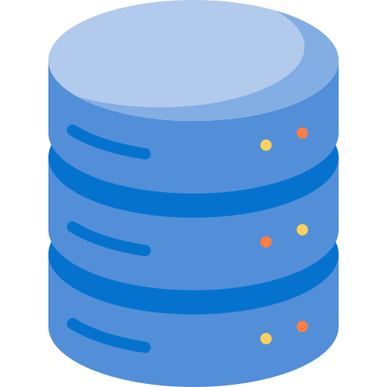
Summary / Conclusion
Add image here (database with checkmark)
A DBMS is built from multiple cooperating software components.
Query Processor: interprets and executes queries.
Storage Manager: manages physical data storage.
Transaction Manager: keeps data safe and consistent.
Together, they allow reliable, efficient database operations.
20

